Slide 1
US SALES DASHBOARD
VISUALIZING DATA USING POWER BI

Slide 2
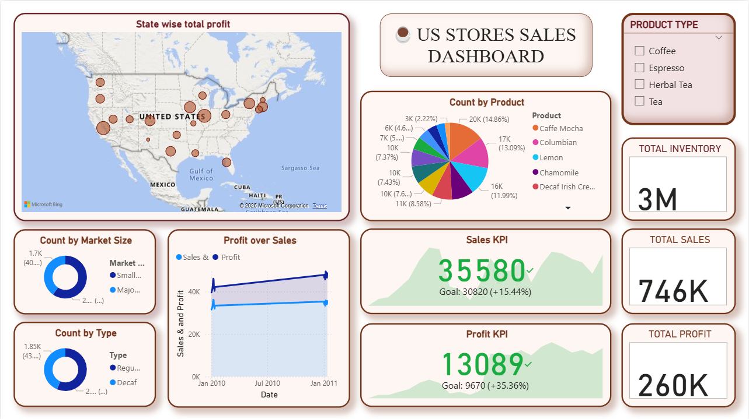
DASHBOARD

Slide 3
SUMMARY
SLICER : In the dashboard the slicer allows us to choose a specific “product type” so that the KPI’s of profit and sales, market size, products , profits across different geographical locations of each product type is visualized respectively.
KPI : The Key Performance Indicator (KPI) od sales and profit is been visualized which represents the growth in sales and profit respectively by comparing it with there targets.
MAP : Geographically represents the total profit earned in each state according to product , market size, etc.,.
PIE CHART : To display the contribution of each product towards its product type.
DONUT CHART : To represent the market size and the type od products sold .

Slide 4
INSIGHTS
OVERALL : The highest profit for the business is from “California” followed by “Illinois”. The highest sold products are “caffe mocha”, “Columbian”, and “lemon”. The business has crossed the sales target by +15.44% and the profit target by 35.36% . The major market is from “small scale” and the major type to product is “regular” .
PRODUCT TYPE wise :
COFFEE : The highest profit from this product type is from “Massachusetts” followed by “New York”. The highest sold product is “Columbian”. The business has crossed the sales target by +4.12% and the profit target by +20.43% . The major market is from “small scale” and the major type to product is “regular” .

Slide 5
INSIGHTS
ESPRESSO : The highest profit from this product type is from “California” followed by “Illinois”. The highest sold products is “caffe mocha”. The business has crossed the sales target by +8.09% and the profit target by +21.64% . The major market is from “small scale” and the major type to product is “regular” .
HERBAL TEA :The highest profit from this product type is from “California” followed by “Lowa”. The highest sold products is “lemon”. The business has crossed the sales target by +23.75% and the profit target by +53.53% . The major market is from “small scale” and the major type to product is “decaf” .
TEA : The highest profit from this product type is from “Lowa” followed by “New York”. The highest sold products are “earl grey” , “Darjeeling”, and “green tea”. The business has crossed the sales target by +34.35% and the profit target by +62.81% . The major market is from “small scale” and the complete type to product is “regular” .

